Slide 1
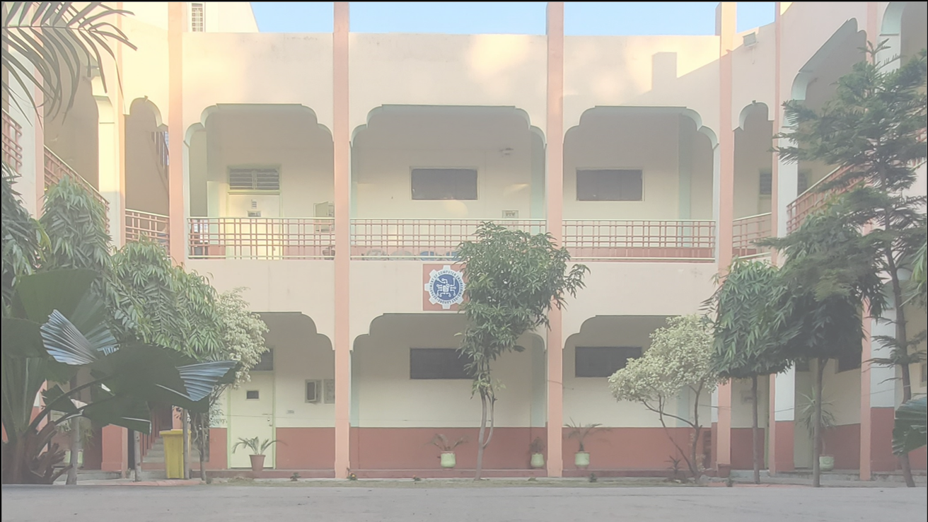


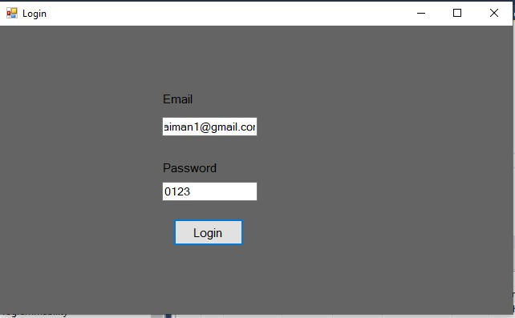
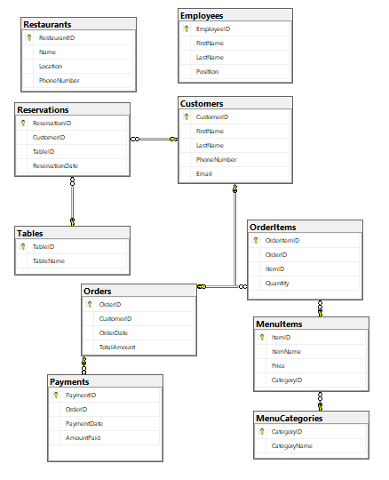
DEPARTMENT OF COMPUTER ENGINEERING
Restaurant Management System
OBJECTIVE
ABSTRACT
Efficiently manage restaurant operations, including orders, tables, employees, reservations, payments, and menus, through the development of a Restaurant Management System.
The Restaurant Management System project is designed to streamline restaurant operations by integrating functionalities for order management, table allocation, employee coordination, reservation handling, payment processing, and comprehensive menu management, enhancing overall efficiency and customer service.
TABLES
Order Item
Restaurants
Menu Categories
Menu Items
Customers
Orders
Tables
Employees
Reservation
Payments
2023-2024 CE Semester Project
Submitted by
Aiman Malik (2021-CE-23)
Submitted to
Sir Waseem
(Course Instructor)

